Slide 1
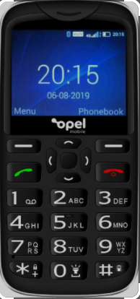
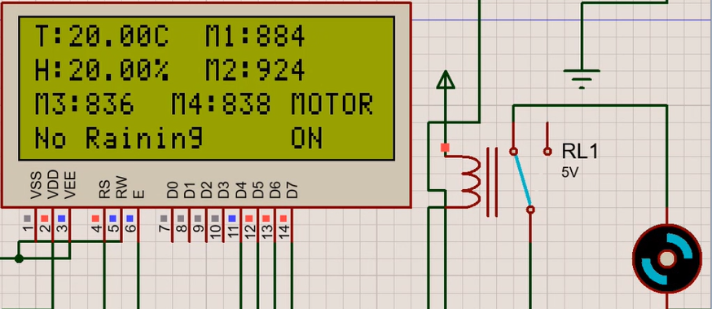
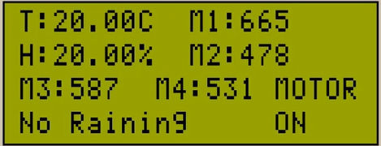
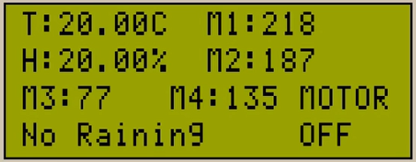
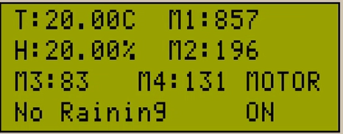
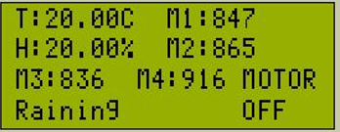








IoT based Smart Irrigation System
Mureed Qasim Shah (2018-UET-NML-ELECT-37), Muhammad Imran (2018-UET-NML-ELECT-17)
Supervised by: Mr. Muhammad Usama, Co-supervised by: Dr. Majid Ali (<Co-supervisor’s Affiliation>)
Department of Electrical Engineering
Abstract
Agriculture in Pakistan uses 93 % of the water that's available while significantly 60% of that water is wasted during Irrigation. The reason behind the wastage of water is the lack of knowledge about irrigation scheduling and proper irrigation system. The possible option is to make irrigation smart using IoT. The leading characteristic of this project is that it will reduce the wastage of water during irrigation alongside many more advantages. The sensors used in the system collect the data from the soil and send it to the IoT web server for easy monitoring of the field. We will design an android mobile application as well as a website so that farmers can monitor their field from anywhere in the country.
Introduction
Design
IoT is the fastest-growing technology in every domain of society, especially in agriculture.
In this project, sensors keep checking the values of humidity, temperature, soil moisture, and rain status and update the data on the website or mobile application.
The Soil moisture sensor is integrated with the rain sensor, if irrigation is turned on and it begins to rain, then our motor pump will turn off automatically.
We also proposed a water drainage system in case of an excessive amount of rainwater. Our project will store the excess amount of rainwater and will use it for irrigation when needed.
The farmer will receive a message on his mobile phone about the update of his field if there is no internet connection for the farmer.
We can maintain the right level of moisture for soil, reduce human efforts, and increase productivity.
Block Diagram
Internet
Humidity
Sensor
Arduino UNO
WIFI Module
ESP8266
Mobile Application
Temperature
Sensor
Soil Moisture
Sensor
GSM Module
Website
Rain
Sensor
Motor
Relay
LCD
Flow Chart
Start
Results
Web/Mobile Application
Condition 1:
If all the Soil Moisture Sensor Values > 700 & No Raining
Microcontroller Initialization
Read Sensors Values
Condition 2:
If all Soil Moisture Sensor Values between 300 to 700 & No Raining
Humidity Sensor
Moistures Sensor
Temperature Sensor
Condition 3:
If all the Soil Moisture Sensor Values < 300 & No Raining
Yes
No
Rain Sensor
Pump OFF
Sensors Values =
Threshold Values
Pump ON
End
Condition 4:
Any One Soil Moisture Sensor Values > 700 & No Raining
Display Sensors Values
Send Data Over Wi-Fi
Condition 5:
If all the Soil Moisture Sensor Values > 700 & Raining
Tools/Technology
Namal University, Mianwali
Affiliated with University of Engineering and Technology, Lahore
Open House 2022

